Slide 1
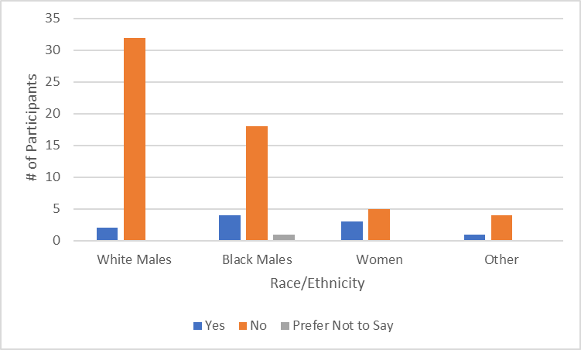
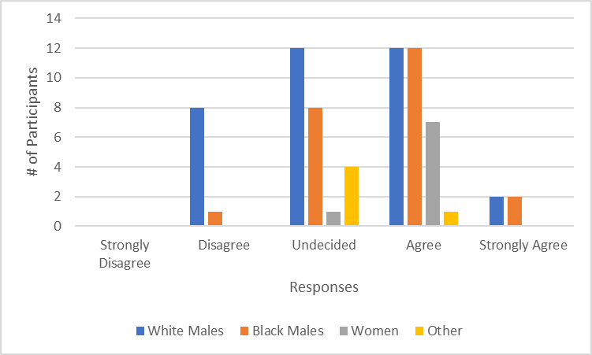
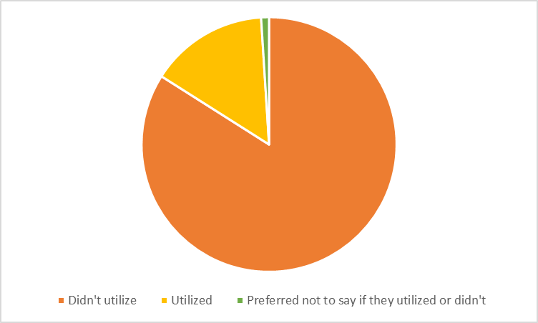
Dynamic Connection of Mental Health and Sports in College Terrence Jordan, McKinley Egland-Young, and Kendrick Maynor. Jr Faculty Mentor: Dr. Kim Flottemesch
Introduction
Throughout universities around the world, the mental health of college students is tested. Specifically, collegiate athletes may feel uncomfortable, or uncertain seeking out resources to assess their overall mental health. There are numerous reasons. “Athletes tend not to seek support for mental health problems, for reasons such as stigma, lack of understanding about mental health and its potential influence on performance, and the perception of help seeking as a sign of weakness” (Rice et al., 2016). Researchers chose to investigate the mental health of two different sports teams at a university. Specifically, the researchers explored these athletes and their mental health state, if they felt comfortable utilizing campus resources, and if they have non-campus provided resources to assess their mental health state. The focus of this study was to better understand the mental health of college athletes across sports, and, if they feel supported on their mental health.
Methods
After gaining approval from The Institutional Review Board, researchers administered a survey in-person to two different sports teams (one male and one female) at a small-faith based Midwest university. Overall, the number of participants in our research study totaled out to 70. Research design consisted of a cross-sectional and field-independent survey. The survey consisted of 12 questions, mainly closed-ended questions and Likert Index Scale statements.
Discussion/Conclusion
Co-Cultural Theory:
Co-Cultural Theory examines the ways in which co-cultural groups (groups which have been historically marginalized) interact with dominant groups (groups which have been historically privileged)” (Razzante & Orbe, 2018).
49% of our participants were white males, 33% were black males, 11% were women, and 7% were either multi-racial and or another specified race/ethnicity.
Bar graph comparing each race/ethnicity in our data and if they were comfortable utilizing MH resources on campus::
Data concluded women are the most comfortable utilizing resources while white males are the least comfortable.
What does this mean in Co-Cultural Theory?
White males were the inferior group when it came to comfortability utilizing resources compared to black males and women
Results
Bar graph comparing each race/ethnicity in our data and if they utilized MH resources on campus:
Representation of participants and their utilization of campus resources:
84% of participants (59) did not utilize campus resources.15% of participants (10) utilized campus resources. 1% of participants (1) preferred not to say if they utilized campus resources.
Researchers used a Chi-Square Test of Association to determine if race/ethnicity as well as age/year in school associated with utilization of MH resources on campus. At (p > 0.55), researchers were able to conclude that race/ethnicity and age/year in school did not impact if participants utilized resources or not. The results also contradicted our research question.
Research Question
Cutler and Dwyer (2020) detailed “There is a direct relationship between lack of self-seeking mental health support and a high level of personal stigma. In a separate study in 2005 results showed that student-athletes have fewer positive attitudes toward help seeking than their nonathlete peers” (p. 210-211). The article also details what goes into the decision-making procedure of these athletes when deciding to seek out mental health resources to assess themselves: “The athlete’s thoughts and feelings towards themselves seeking help, their perceptions of their fellow athletes’ thoughts on seeking help, and the general public’s thoughts on seeking help” (Cutler & Dwyer, 2020, p. 211). For this study, researchers examined athlete’s access to resources.
RQ 1: How are athletes utilizing campus resources for managing mental health?
Limitations and Further Research
Limitations: This study surveyed only two sports teams, which limited results.
Further Research: Further research includes potentially surveying a larger number of individuals in the nearby area, or even the state.
References
Cutler, B. A., & Dwyer, B. (2020). Student-Athlete Perceptions of Stress, Support, and Seeking Mental Health Services. Journal of Issues in Intercollegiate Athletics.
Razzante, R. J., & Orbe, M. P. (2018). Two sides of the same coin: Conceptualizing dominant group theory in the context of co-cultural theory. Communication Theory, 28(3), 354-375.
Rice, S.M., Purcell, R., De Silva, S. et al. The Mental Health of Elite Athletes: A Narrative Systematic Review. Sports Med 46, 1333–1353 (2016). https://doi.org/10.1007/s40279-016-0492-2

